Slide 1

Creating parallel-transmission-style MRI with deep learning (DeepPTx): a feasibility study using high-resolution whole-brain diffusion at 7 Tesla
Xiaodong Ma, Kâmil Uğurbil, and Xiaoping Wu
Center for Magnetic Resonance Research, Radiology, Medical School, University of Minnesota, Minneapolis, MN, United States

Slide 2
Introduction
Parallel transmission (pTx)
Capable of improving RF non-uniformity and reducing power deposition in tissues at ultrahigh fields (≥7 Tesla)
Tedious workflow, special expertise required
Proposed DeepPTx
A novel user-friendly pTx framework with deep-learning
pTx-style images predicted from single transmission (sTx) images using a trained neural network
Demonstrated on 7 Tesla high-resolution, whole-brain diffusion MRI data
[1] Wu X, et al. MRM 2018;80:1857-1870

Slide 3
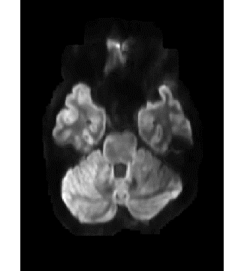
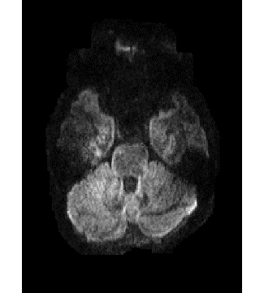
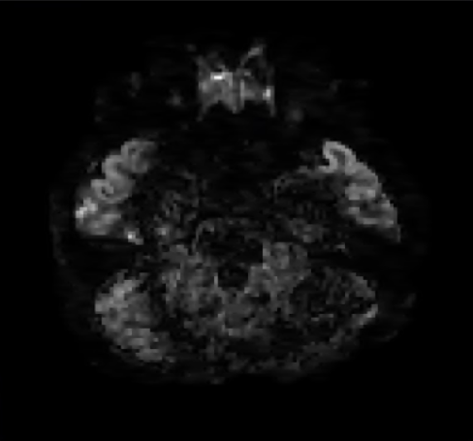
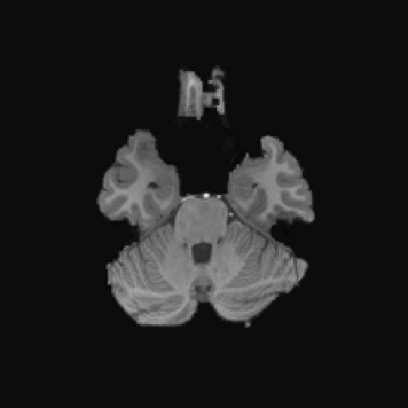
Methods - Neural network
Deep encoder-decoder convolutional neural network (CNN) ^{[1,2]}
3x3 Conv, BNorm, ReLU
2x2 Max Pooling
2x2 Upsampling
Concatenate connection
1x1 Conv
Addition
Input
(T1W + sTx)
Output
(pTx-style)
Encoder layers
Decoder layers
[1] Ronneberger, O., et al., MICCAI, 2015. [2] Gong, E., et al. (2018). JMRI, 48(2), 330–340.
Notes:
The neural network takes single-transmission (sTx) diffusion and T1-weighted (T1w) MPRAGE images as input and spits out the parallel-transmission (pTx) version of diffusion images. It has N encoder levels and N decoder levels with N of 3 here. Each encoder level has a 2x2 polling layer followed by two (Conv-BN-ReLU); each decoder level contains a 2x2 upsampling layer, followed by two repetitions of the 3x3 Conv-BN-ReLU operation. The number of channels were double after each downsampling layer, and were halved after each upsampling layer. Concatenated skip connections are added between corresponding encoder and decoder levels to reduce resolution loss, and a global addition connection is appended to promote the training performance by enabling residual learning.

Slide 4
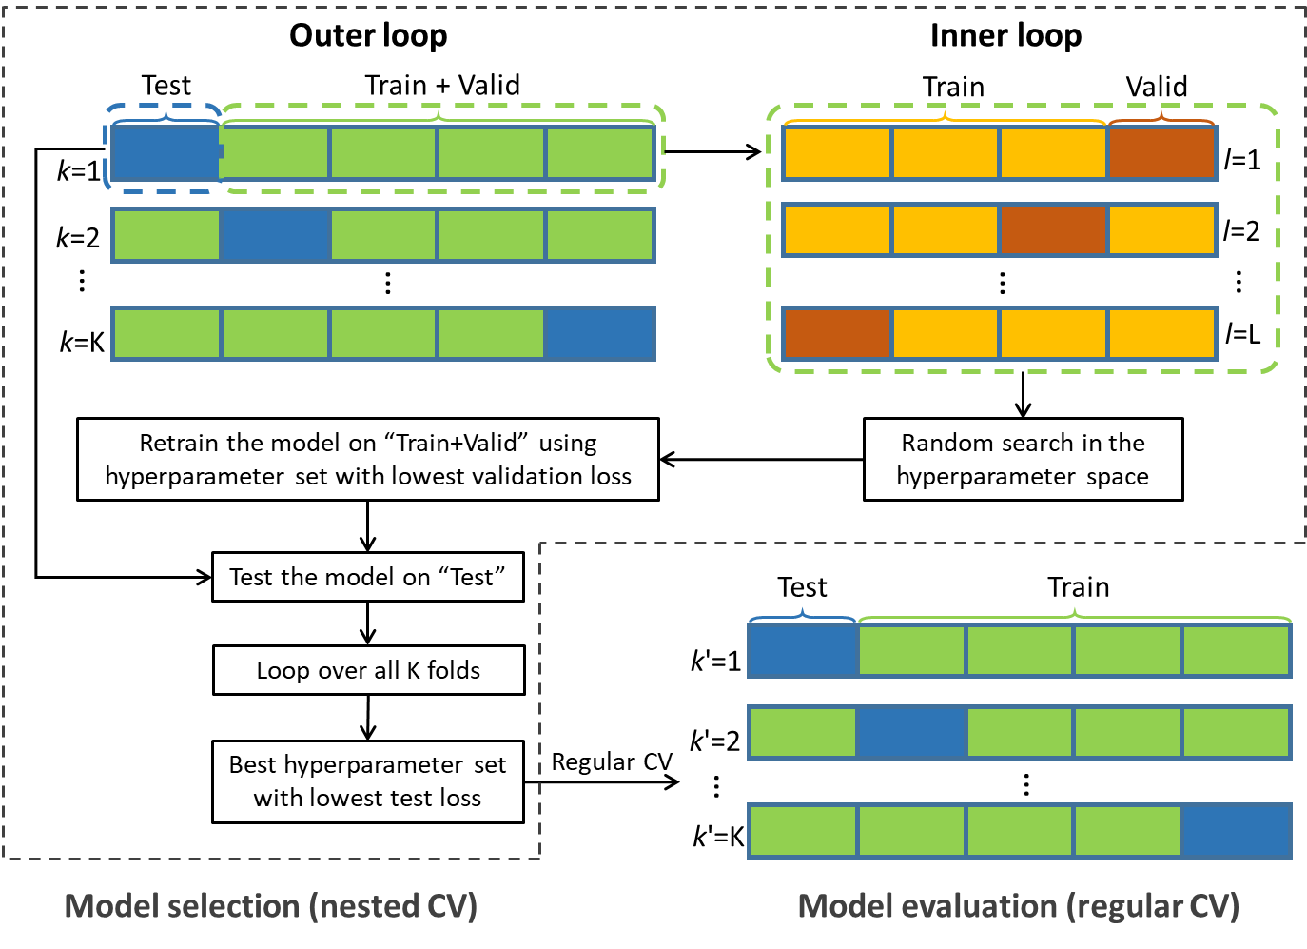
Methods - Training
Dataset ^{[1]}
7T dMRI data from 5 subjects
sTx and pTx, b=1000s/mm²
18,000 samples in total (5 subjs x 36 vols x 100 slices)
Hardware and software
24GB NVIDIA TITAN RTX GPU
Julia Language, Adam optimizer
Model selection and evaluation using CV
[1] Wu X, et al. MRM 2018;80:1857-1870

Slide 5
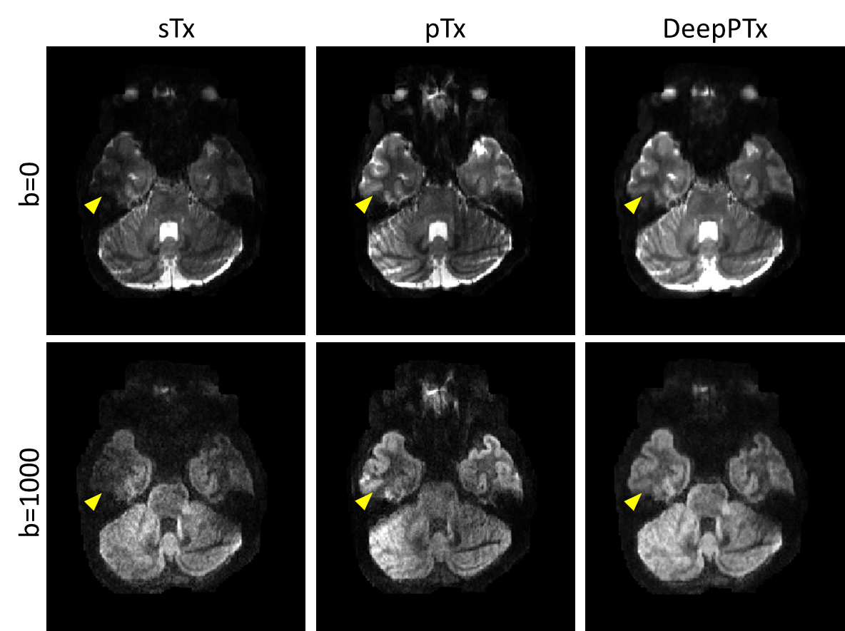
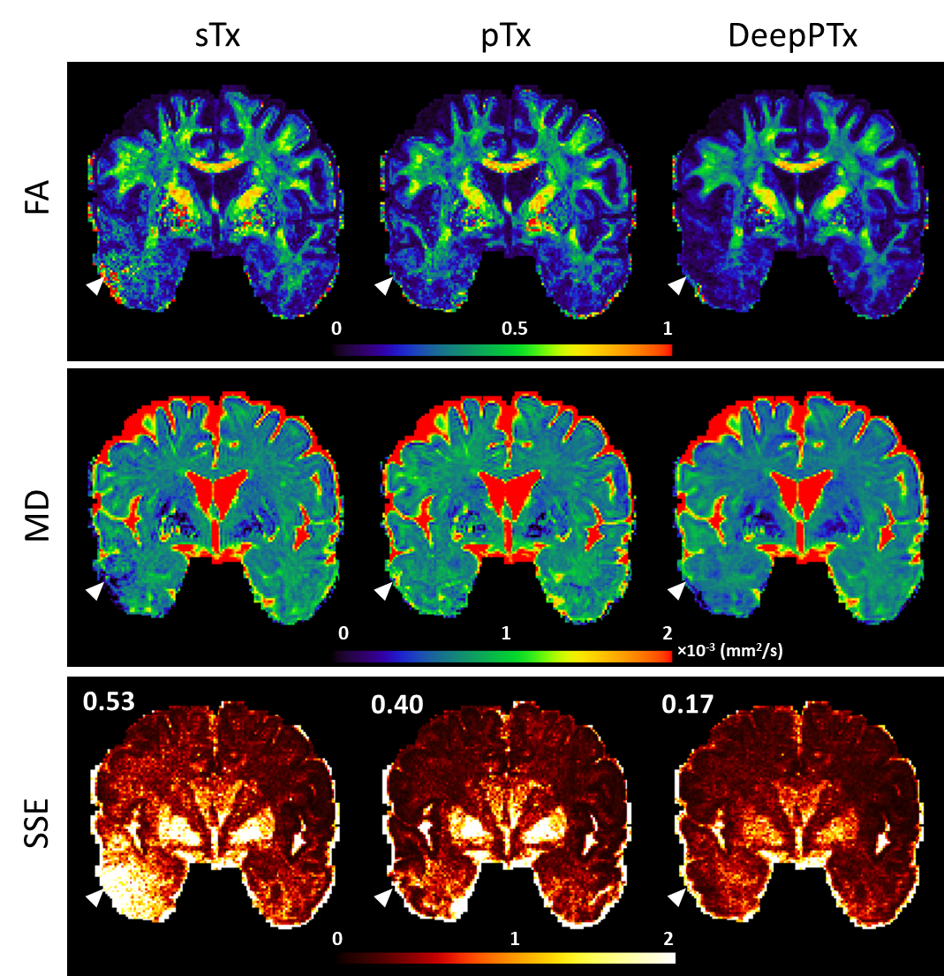
Results
Notes:
Results showed that compared with single transmission (sTx) diffusion images, DeepPTx substantially improved the image quality by effectively recovering the signal dropout observed in the lower temporal lobe (as marked by the yellow arrowheads), producing images that were comparable to those obtained with pTx.
The improved image quality can be translated into better DTI calculation, as shown on the right. DeepPTx provided increased quality and accuracy for both FA and MD estimations especially in the lower temporal lobe, and substantially decreased the fitting error.

Slide 6
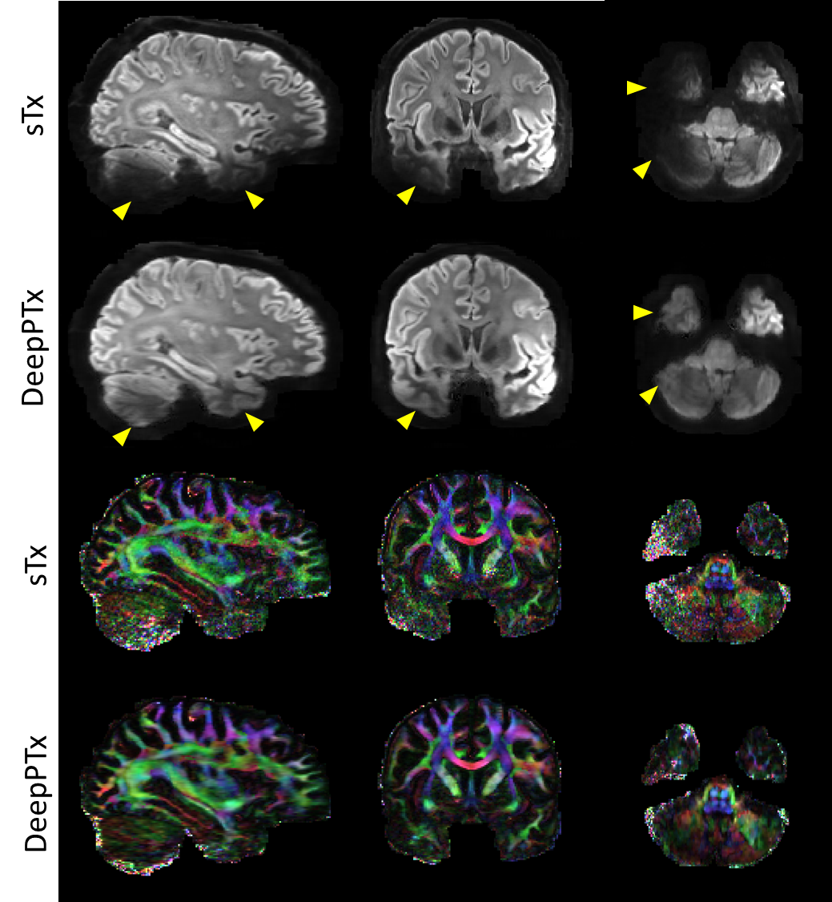
Results
Model test on a new subject from HCP database
Signal dropout restored in DeepPTx images
Color-coded FA map with largely reduced noise levels
Notes:
The test of our model on a new subject from HCP database suggests that DeepPTx can improve the quality of diffusion-weighted images with restored signal dropouts and enhance the quality of FA maps with higher SNR and clearer fiber orientation representation. This is encouraging as it shows the neural network trained on existing image dataset can be applied to data of new subjects.

Slide 7
Conclusion and discussion
DeepPTx
A deep-learning approach that can directly map sTx images to their pTx counterparts
Image quality and the downstream diffusion analysis substantially improved compared
Potential to become a user-friendly pTx workflow even when pTx resources (including pTx expertise, software or hardware) are inaccessible on the user side
Future work
To evaluate the prediction performance with a focus on regions with extremely low SNR
To study how our method may work when there is pathology
To investigate how the prediction accuracy can be improved by increasing training data, refining the network structure, and using other machine learning frameworks (e.g., GAN)
Notes:
In conclusion, we have introduced and demonstrated a deep-learning approach that can directly map sTx images to their pTx counterparts. Our results using 7T high-resolution whole-brain diffusion images show that our approach can substantially improve image quality by effectively restoring the signal dropout presenting in sTx images, therefore improving the downstream diffusion analysis. As such, our approach shows great potential to become a user-friendly pTx workflow that can provide pTx-style image quality even when pTx resources (including pTx expertise, software or hardware) are inaccessible on the user side.
In future, we plan to …

Slide 8
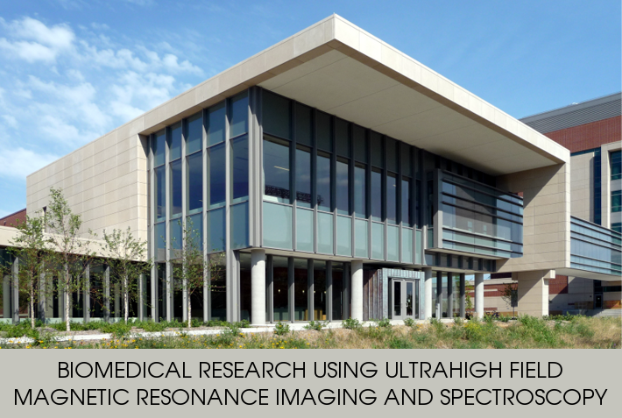

Acknowledgements
John Strupp, Brian Hanna and Jerahmie Radder who helped in setting up computation resources
NIH grants U01 EB025144, P41 EB015894 and P30 NS076408
Notes:
Finally I would like to thank.. And three NIH grants. Thank you very much!

